Slide 1
Digital Photography
This completed project is worth 100pts.
Final Exam Review Assignment
DIRECTIONS
Answer the following questions using resources on the class website. Also, think about what we did, or discussed in class to help answer these questions.

Slide 2
Adobe Photoshop is a…

Slide 3
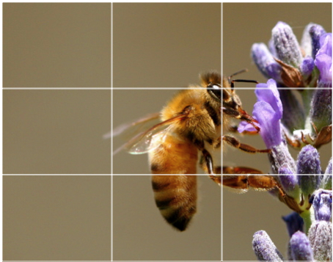
This photo is a good example of the…

Slide 4
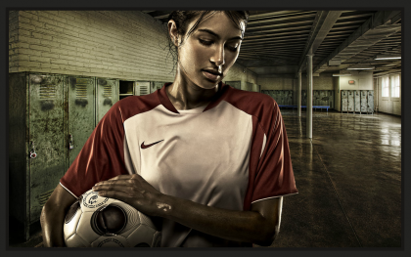
A photo composite is a…
http://thomaslthsdigitalphoto.weebly.com/photo-composite-1---realistic.html

Slide 5
What is camera obscura?

Slide 6
What is a contact sheet?

Slide 7
What are the 6-points in the editing system we used for Camera Raw?

Slide 8
What is light painting?

Slide 9
Is the shutter speed slow or fast when light painting?

Slide 10
What is Macro photography?

Slide 11
How do you “lock” in focus a photo with a digital camera…
http://www.wikihow.com/Take-a-Picture-with-a-Digital-Camera

Slide 12
If you do not “lock” in your focus, this will occur…
http://www.wikihow.com/Take-a-Picture-with-a-Digital-Camera

Slide 13
Pictures that you intend to post on the Internet should have their resolution set to…
http://thomaslthsdigitalphoto.weebly.com/calendar.html
Click on Digital vs. Film from week 2

Slide 14
Resolution is digital photography refers to…

Slide 15
When you print out a digital photo and the pixels per inch are too few, the result will be…
http://thomaslthsdigitalphoto.weebly.com/calendar.html
Click on Digital vs. Film from week 2

Slide 16
The purpose of cropping your digital picture is…

Slide 17
When shooting your photos on a bright sunny day, this is one of the disadvantages…

Slide 18
Depth of Field refers to…

Slide 19
David Hockney created combinations of photos inspired by this art movement:
http://thomaslthsdigitalphoto.weebly.com/hockney-photocubism.html

Slide 20
List 10 Tips for taking better pictures…
http://www.kodak.com/global/en/corp/top10tips/index.jhtml

Slide 21
Turn your flash off in this instance to create a better photo…
http://www.slate.com/articles/technology/technology/2010/10/how_to_take_better_family_photos.html

Slide 22
Portraiture is…
http://thomaslthsdigitalphoto.weebly.com/self-portrait-project.html

Slide 23
The word pixel is a shortened form of these two words…

Slide 24
When you print a picture on a ink jet printer and you want bright “shiny” photos, choose this type of paper… highlight the correct answer in Red!
glossy photo paper
matte paper
copy paper
none of the above

Slide 25
What commands are used to resize a photo in Photoshop… highlight the correct answer in Red!
Edit > Free Transform
Edit > Fill
Edit > Change
Redo

Slide 26
This is a key element/s in picture quality in digital camera… highlight the correct answer in Red!
Resolution, and lens quality
memory card
manufacturer
image size

Slide 27
Why would a photographer want to create a pop of color in their photograph…

Slide 28
Digital photos can be… highlight the correct answer in Red!
be shared electronically
be printed
be digitally manipulated
all of the above

Slide 29
The LCD screen in a digital camera is used for…
http://digital-photography-school.com/should-i-use-the-lcd-or-viewfinder-on-my-digital-camera

Slide 30
A JPG is…

Slide 31
A PSD is…

Slide 32
A megabyte is… highlight the correct answer in Red!
an amount of computer memory consisting of one million bytes
amount of pixels on your screen
resolution of image
memory card resolution

Slide 33
PPI stands for… highlight the correct answer in Red!
pixels pay instead
pixels per inch
pixels per paper
pixels pixel inch

Slide 34
What are digital images measured in…

Slide 35
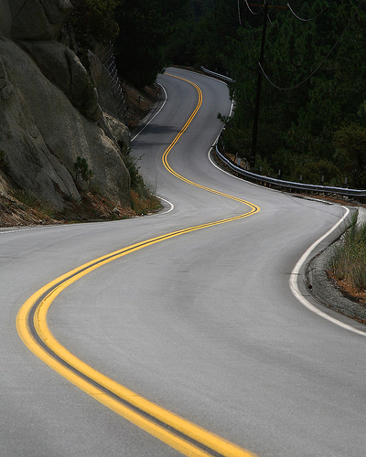
What rule of composition does this image show?
http://thomaslthsdigitalphoto.weebly.com/uploads/9/8/2/3/9823286/photographycompositionassignment.pdf

Slide 36
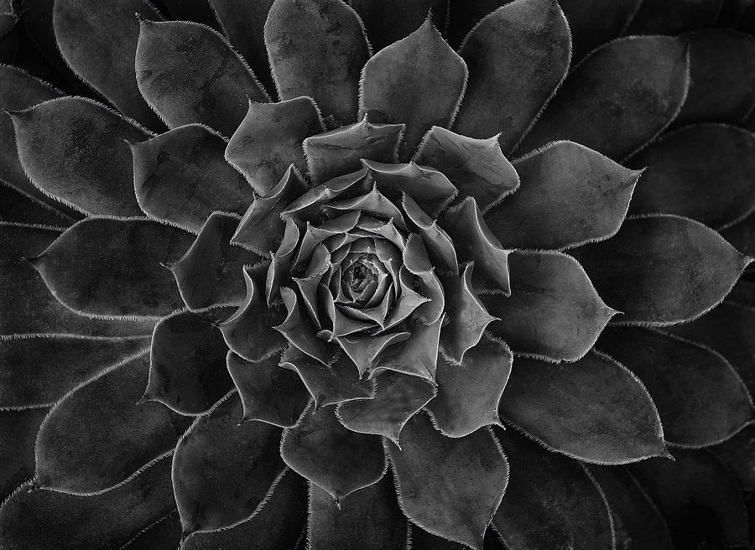
What rule of composition does this image show?
http://thomaslthsdigitalphoto.weebly.com/uploads/9/8/2/3/9823286/photographycompositionassignment.pdf

Slide 37
A pixel is…

Slide 38
Resolution in digital photography refers to…

Slide 39
The Exposure Triangle is…
http://thomaslthsdigitalphoto.weebly.com/photography-fundamentals.html

Slide 40
Aperture is…
http://thomaslthsdigitalphoto.weebly.com/photography-fundamentals.html

Slide 41
Shutter Speed is…
http://thomaslthsdigitalphoto.weebly.com/photography-fundamentals.html

Slide 42
What is shallow depth of field?

Slide 43
What is deep depth of field?

Slide 44
What is abstraction?
http://thomaslthsdigitalphoto.weebly.com/photo-shoots.html

Slide 45
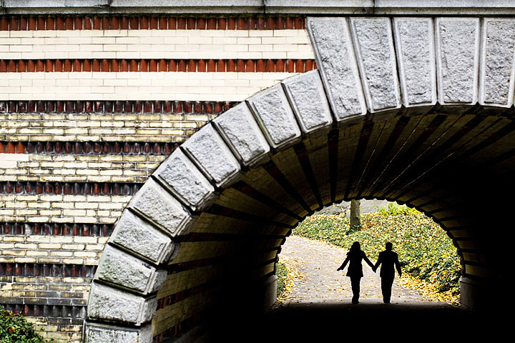
What rule of composition does this photo show?

Slide 46
When it comes to technical quality of a photo, name 6 things a photographer should consider?
http://thomaslthsdigitalphoto.weebly.com/journals.html

Slide 47
How do you change the size of an image in photoshop?

Slide 48
What is a double exposure?
http://thomaslthsdigitalphoto.weebly.com/double-exposure.html

Slide 49
What does emotional appeal refer to in photography?
http://thomaslthsdigitalphoto.weebly.com/journals.html

Slide 50
What is a photo essay?
http://thomaslthsdigitalphoto.weebly.com/photo-essay.html

Slide 51
ISO is…
http://thomaslthsdigitalphoto.weebly.com/photography-fundamentals.html

Slide 52
What is the difference between a RAW image and a jpeg?

Slide 53
List the 7 Photography composition rules that we focused on…
http://www.photographymad.com/pages/view/10-top-photography-composition-rules

Slide 54
List the Elements of Photography…
http://thomaslthsdigitalphoto.weebly.com/photography---elements--principles-powerpoint.html

Slide 55
List the Principles of Photography…
http://thomaslthsdigitalphoto.weebly.com/photography---elements--principles-powerpoint.html

Slide 56
Finished?
Save this as YOUR LAST NAME_Final Review presentation to the following location:
V: drive folder > digital photography > class folder > Final Review

